Slide 1
Secure Data Hiding in Image Using Steganography
CAPSTONE PROJECT
Presented By: Juhi N Poddar
Student Name : Juhi N Poddar
College Name & Department : IIT Patna AI&DS

Slide 2
OUTLINE
Problem Statement
Technology used
Wow factor
End users
Result
Conclusion
Git-hub Link
Future scope

Slide 3
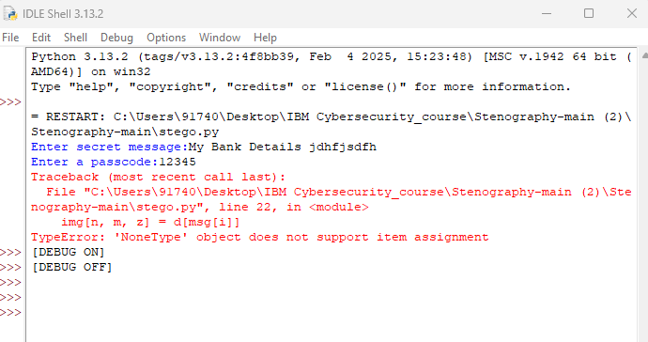
Problem Statement
At the time of execution I faced the problem of the library cv2 module not found.
And while executing the code I also faced the issue of image which was not supporting with the python code.

Slide 4
Technology used
Technology Used: Python , Cmd
Libraries : cv2, os module , numpy , string
Operating System : Windows 10
Hardware Requirements: Core i3 or higher,(cache- 3MB or 4MB recommended) , Memory(RAM): Minimum 2GB

Slide 5
Wow factors
The wow factor of this project is that the code/data is inside the image which is not visible without the secret code.
AES

Slide 6
End users
The end users like The Bankers, The government organization like RAW ,The Military personnel, The Ethical hackers, The Forensic Department, and the individuals who need to securely transmit sensitive information discreetly.
They utilize the technology to hide secret messages within seemingly normal files like images, audio, or video, making it difficult to detect the hidden data.

Slide 7
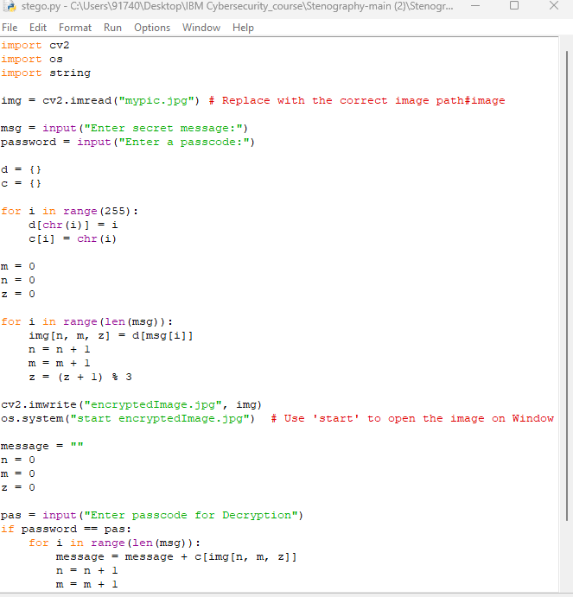
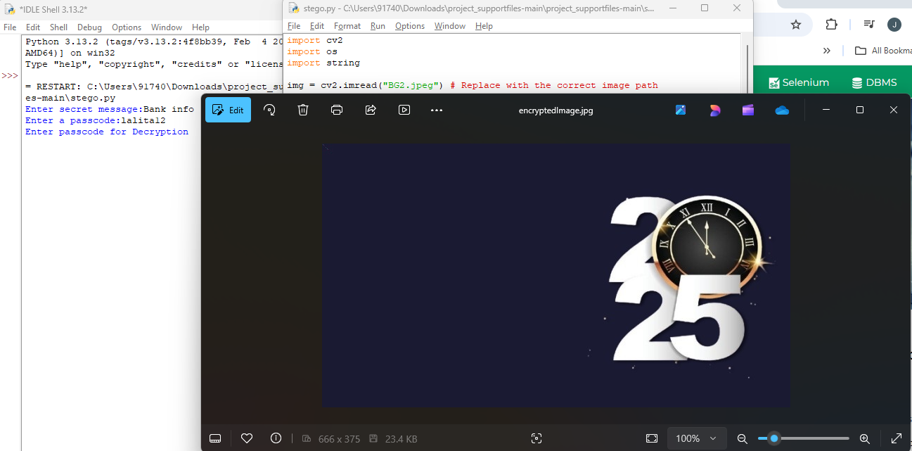
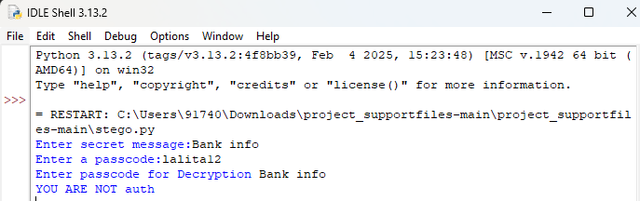
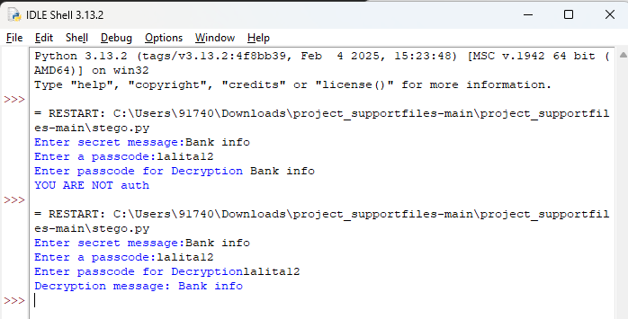
Results
Code
Output with image
Output with wrong secret code
Output with correct secret code

Slide 8

Conclusion
As discussed earlier in problem statement my conclusion is that…
For the library which was not supporting to my idle page of Python I tried using it through command prompt
Also I tried using idle page through command prompt tried to run the code but still faced a lot of errors.
Again I reinstall the python and opencv libraries.
For the image I replaced the extension(.png) which I was using and faced the image error by (.jpeg) by this way I sort my issues.

Slide 9
GitHub Link
https://github.com/Jpoddar26/stegano_proj.git

Slide 10
Future scope(optional)
Though our project is able to reach highly accepted results and is able to hide data very efficiently, it can definitely be improved in some areas.
To make the communication more secured and impossible to hack, various existing ciphers can be implemented with the steganography algorithms.

Slide 11
THANK YOU

